Slide 1
Reflections of Race/Ethnic Variations in COVID-19: A Moving Portrait
Rogelio Sáenz
University of Texas at San Antonio
rogelio.saenz@utsa.edu
2022 Southern Demographic Association Luncheon Plenary Address. Knoxville, TN. October 19, 2022.

Slide 2
Outline
Introductory remarks
Getting started on Latino COVID-19 research
Theoretical grounding
Shifting context of COVID-19 mortality
Data sources and methods
Early and more recent findings on Latinos
COVID-19 beyond Latinos
Closing remarks

Slide 3
Introductory Remarks
Approximately 2.5 years of research on COVID-19 deaths beginning with some of earliest work on the Latino population and extending to other groups of color and whites
The devastation of COVID-19 on populations of color has been tremendous
In August 2020, Blacks and Latinos dying from COVID-19 at rates more than 3 times higher than whites
In 2021, Indigenous Peoples overtook Latinos as group with highest COVID-19 death rate
Major changes have occurred with racial gaps getting narrower over time, especially since 2021
Cumulative Age-Adjusted Death Rates (1/1/2020-1/22/2022): Compared to whites, Indigenous People dying at rates 2.1 times higher, Latinos 1.9 times higher, Blacks 1.7 times higher, and Asians 23% lower
As in other social phenomena, whites have some protection due to structural racism advantages but eventually they too were impacted, albeit much later at lower levels of intensity than people of color
I’ll highlight work that I have been doing on Latinos and then transition to broader COVID-19 trends

Slide 4
Getting Started on Latino COVID-19 Research
Mid-March to early April 2020
Clear COVID-19 particularly brutalizing people of color
Early on limited data for Blacks, much less for Latinos
I started collecting and analyzing data and writing about what was happening
Latino Decisions blogs; Latino Rebels; Poynter; San Antonio Express-News; Dallas Morning News
Continual tracking and analysis

Slide 5
Theoretical Grounding
Systemic racism as the culprit
For long much denial regarding systemic racism and white supremacy
The pandemic, the murder of George Floyd and other folks of color made it difficult to deny
Confluence of racial inequities
Significantly higher infection and death rates from COVID-19 than whites
Essential workers on the front lines in essential industries
The loss of jobs and the lack of job recovery
The lack of medical insurance
Crowded living conditions and multigenerational households
Unauthorized immigrants left to fend for themselves
These inequalities did not just crop up during the pandemic, but reflect centuries and generations of neglect of people of color
Sabrina Strings had an excellent op-ed in New York Times summer 2020 where she illustrates with the concept of “bare necessities” for Blacks and other people of color extending back to slavery and the racial subjugation of other groups of color

Slide 6
Shifting Context of COVID-19 Mortality
One of major lessons learned from pandemic is that change is constant
Early on afflicting population centers with high international travel volume and population density
Weather and social variations
COVID-19 mutations
Race/ethnic shifts in COVID-19 mortality
The politics of the pandemic including masks, the vaccine, and misinformation
Each of these factors in one way or another has contributed to changes in the temporal aspects of the timing in surges and dips that race/ethnic groups have experienced over the la

Slide 7
Data Sources
Data sources that I have used
Originally compiled data from state data portals
The COVID Tracking project (https://covidtracking.com/) and COVID Racial Data Tracker (https://covidtracking.com/race)
CDC Health Disparities: Race and Hispanic Origin [provisional death counts] (https://www.cdc.gov/nchs/nvss/vsrr/covid19/health_disparities.htm)

Slide 8
Early Findings on Latinos

Slide 9
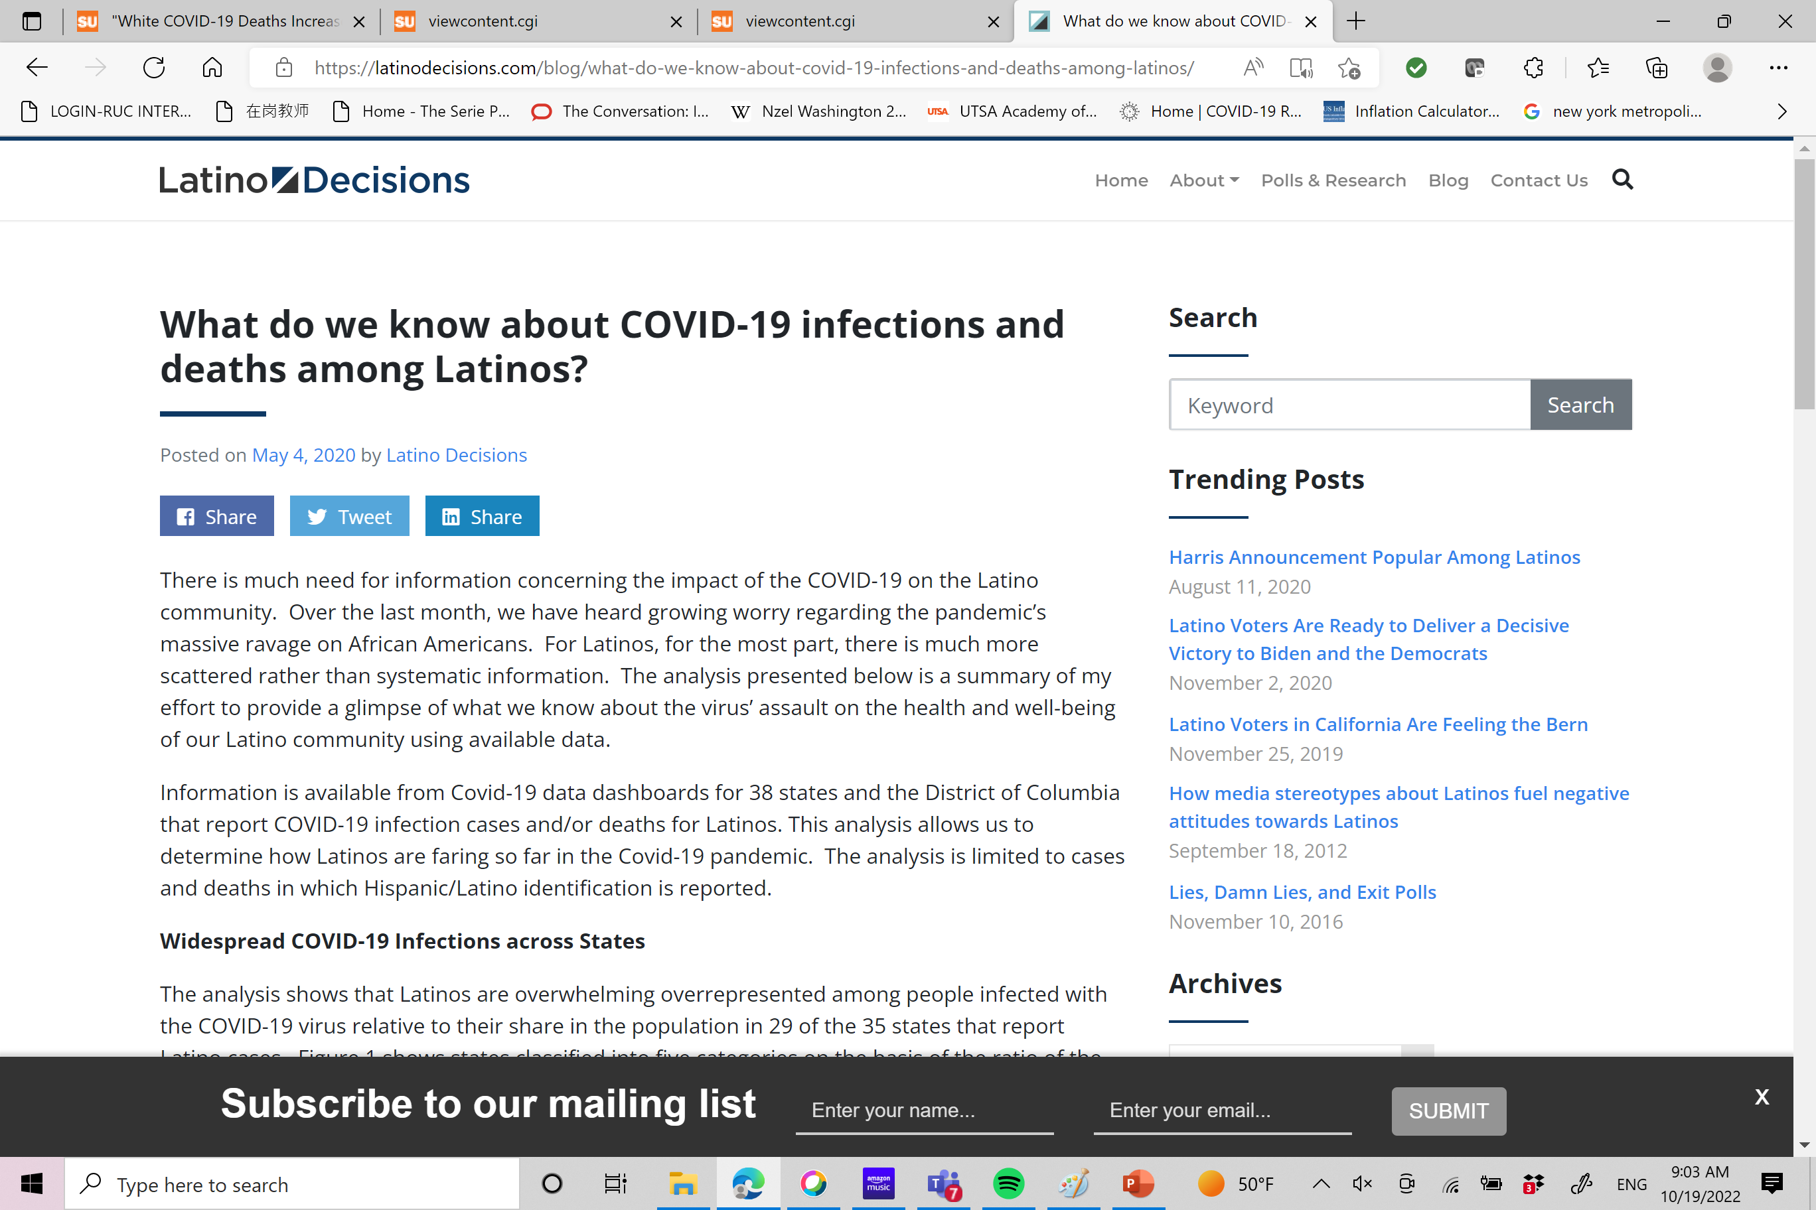
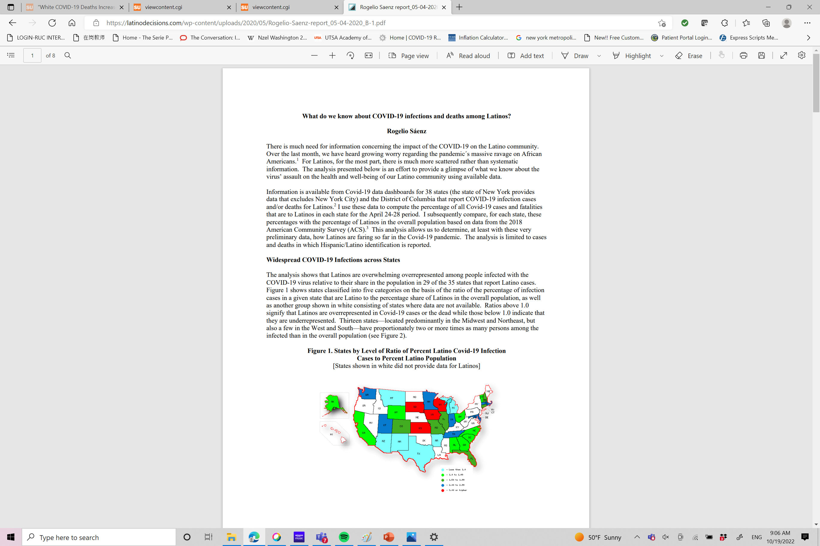

Slide 10
Two Stories: Latino Cases and Latino Deaths due to COVID-19

Slide 11
Number of States Where Latinos are Overrepresented among COVID-19 Cases and Deaths by Month
Indicators of COVID-19 | May 2020 | June 2020 | July 2020 | Aug. 2020 | Sept. 2020 | Feb. 2021
States where Latinos overrepresented among COVID-19 cases | 29 of 35 | 43 of 44 | 45 of 46 | 45 of 46 | 45 of 46 | 44 of 46
States where Latinos overrepresented among COVID-19 deaths | 1 of 29 | 6 of 41 | 16 of 46 | 21 of 46 | 19 of 46 | 6 of 48

Slide 12
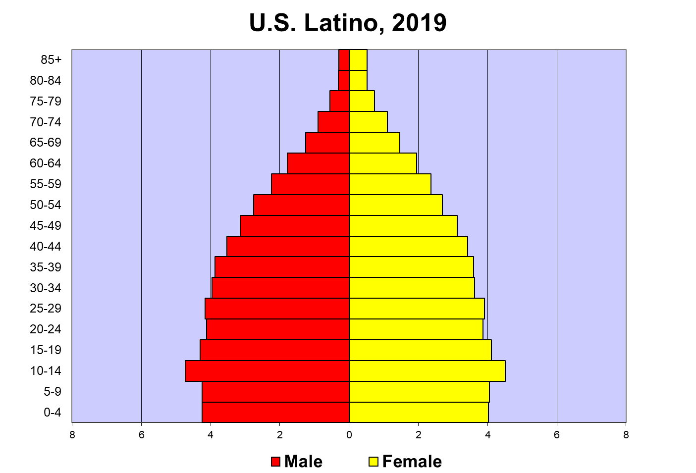
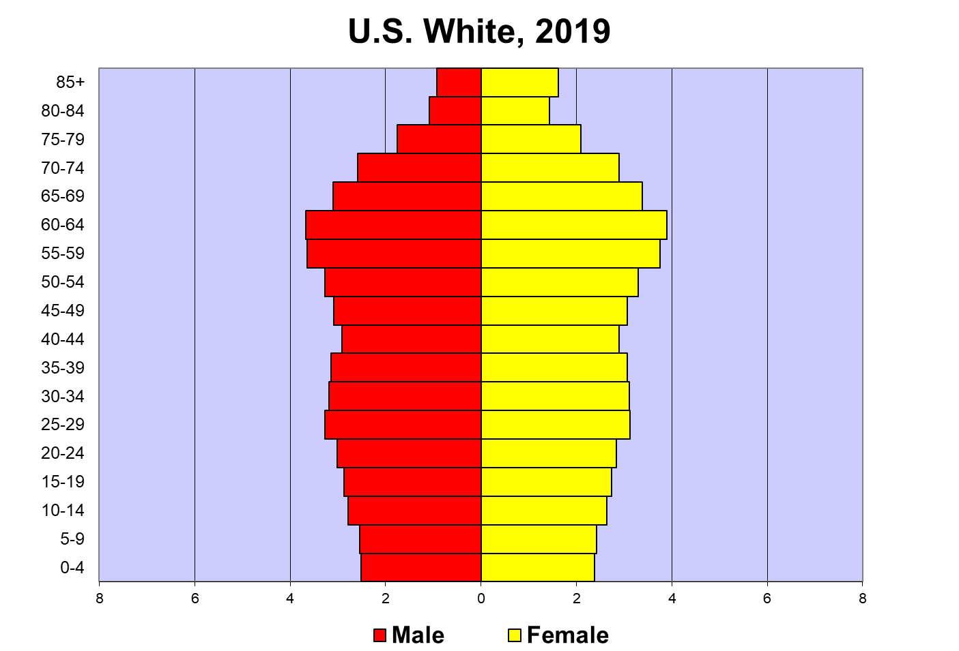
A Paradox Explained by Demography 101
Indicator | Latino | White
Median age | 29.8 | 43.7
Pct. 0-17 | 30.8 | 18.6
Pct. 65+ | 7.7 | 20.9

Slide 13
The Reality: Ratio of Specific Group-to-White Age-Adjusted COVID-19 Death Rates in September 2020

Slide 14
Telling the Story of Devastation of COVID-19 on Latinos, Highlighting Texas Rio Grande Valley

Slide 15
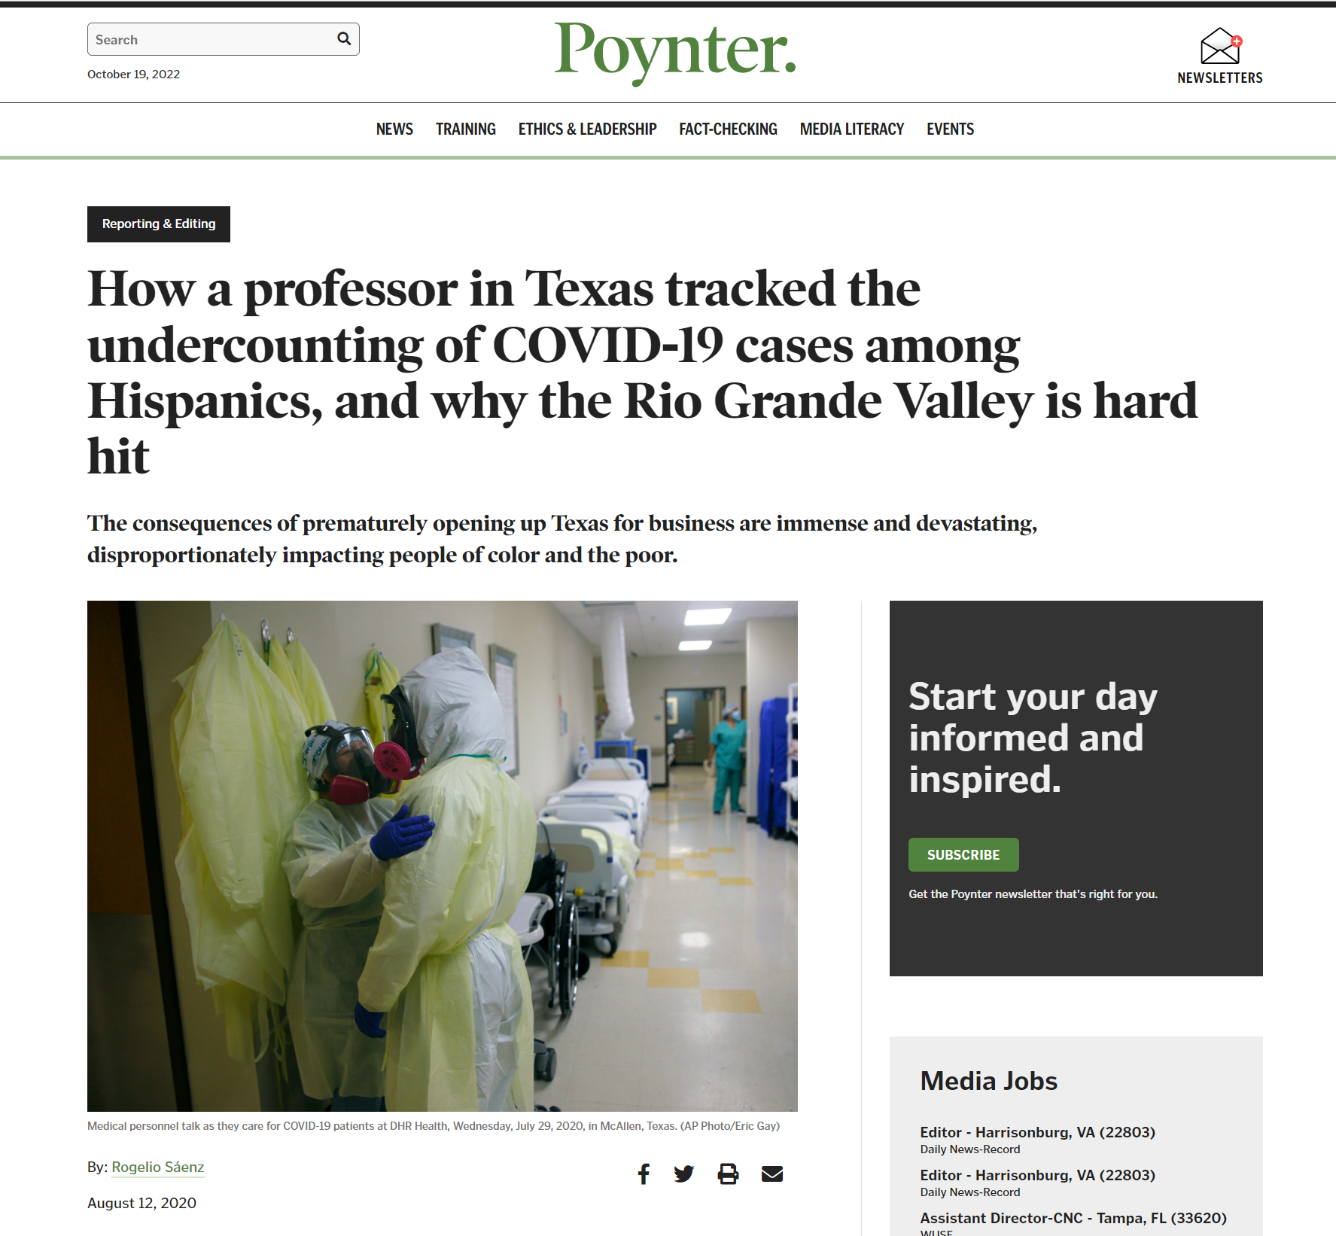

Slide 16
COVID-19 and the Latino Paradox

Slide 17
The Impact of COVID-19 on the Latino Paradox
The Latino Paradox
Despite Latinos, in comparison to whites, having lower SES, lower educational attainment, higher levels of poverty, higher participation in more physically demanding and dangerous jobs, higher portions of people being immigrants and having unauthorized status, and lower levels of health insurance coverage, Latinos have lower death rates and longer life expectancies than whites
Evidence for three decades or so
On average, the death rate of Latinos in 2019 was 29% lower than that of whites
Does the Latino paradox hold during the pandemic?

Slide 18
The Disproportionate Impact of COVID-19 on Older Black and Latino Adults
Saenz and Garcia. (2021). The Disproportionate Impact of COVID-19 on Older Latino Mortality: The Rapidly Diminishing Latino Paradox. The Journals of Gerontology: Series B.

Slide 19
For older Latinos, Latino Paradox for non-COVID deaths
Saenz and Garcia. (2021). The Disproportionate Impact of COVID-19 on Older Latino Mortality: The Rapidly Diminishing Latino Paradox. The Journals of Gerontology: Series B.

Slide 20
Narrowing Latino paradox for death from all causes
Saenz and Garcia. (2021). The Disproportionate Impact of COVID-19 on Older Latino Mortality: The Rapidly Diminishing Latino Paradox. The Journals of Gerontology: Series B.

Slide 21
Ratio of Latino-to-White ASDRs for Total Deaths, Selected Time Periods
Cumulative
End Date | 55-64 | 65-74 | 75-84 | 85+
08/30/2000 | 0.988 | 1.028 | 0.959 | 0.840
10/17/2020 | 1.000 | 1.039 | 0.961 | 0.840
12/26/2020 | 0.996 | 1.026 | 0.945 | 0.822
01/30/2021 | 1.025 | 1.055 | 0.961 | 0.822
02/27/2021 | 1.053 | 1.079 | 0.976 | 0.828
03/27/2021 | 1.065 | 1.091 | 0.983 | 0.833
04/24/2021 | 1.026 | 1.069 | 0.964 | 0.826
05/29/2021 | 1.008 | 1.049 | 0.949 | 0.819
06/26/2021 | 0.999 | 1.040 | 0.943 | 0.818
7/31/2021 | 0.988 | 1.025 | 0.934 | 0.815
08/28/2021 | 0.985 | 1.022 | 0.933 | 0.817
09/25/2021 | 0.976 | 1.009 | 0.924 | 0.813
10/30/2021 | 0.970 | 0.9998 | 0.916 | 0.810
10/8/2022 | 0.875 | 0.920 | 0.854 | 0.765

Slide 22
Factors Accounting for Shifts?
Major COVID-19 surges impacting Latinos, Blacks, and Native Americans much earlier compared to whites
More recent white surges associated with opposition to vaccinations, especially in solidly red states
Latinos have gotten vaccinated in areas particularly hard hit by COVID-19 last year (e.g., Texas border region)
Most susceptible Latinos with preexisting chronic conditions succumbed early on, leaving those with healthier profiles alive

Slide 23
Ratio of Latino-to-White ASDRs for Total Deaths, January 1, 2020 to October 8, 2022

Slide 24
The Overall Impact of COVID-19 on Overall Latino Mortality
In 2019, the AADR (all causes) of Latinos was 29% lower than that of whites
During the January 1, 2020-October 28, 2022, the AADR (all causes) of Latinos is 15.5% lower than that of whites

Slide 25
Latino Years of Life Lost in Texas

Slide 26
Dallas Morning News Estimate of Person-Years Lost to COVID-19 in Texas by Race/Ethnic Groups: Feb. 1, 2020-Dec. 5, 2020

Slide 27
“A milestone of misery: More than 100K US Latinos have died from COVID-19” https://www.latinorebels.com/2021/04/15/amilestoneofmisery/

Slide 28
More Recent Trends on Latinos

Slide 29
Latinos continue to die from COVID-19 at much higher rates than whites across all ages, but declining gaps at all ages especially less than 75

Slide 30
Shifts in top ten states with highest Latino COVID-19 death rates per 100,000 persons

Slide 31
COVID-19 Beyond Latinos

Slide 32
Narrowing Race/Ethnic Gaps in COVID-19 Deaths, But Still Big Differences

Slide 33
Gaps in age-adjusted COVID-19 death rates between People of Color and whites remain large, but have narrowed

Slide 34
The Consistent and Slightly Changing Demography of COVID-19 Fatalities

Slide 35
The demography of COVID-19 fatalities: Older whites, but younger Persons of Color (1-1-2020 to 10-8-2022)

Slide 36
States with Highest COVID-19 Death Rates

Slide 37
Top ten states with highest AIAN, Asian, Black, Latino, and White COVID-19 age-adjusted death rates per 100,000 persons (1/1/2020 to 10/8/2022)

Slide 38
Temporal Trends on COVID-19 Deaths among Racial/Ethnic Groups

Slide 39
Methods
Data analysis
Weekly COVID-19 deaths for selected race/ethnic groups (Jan. 1, 2020 to Dec. 26, 2021; 104 weeks)
AIAN (Indigenous Peoples), Asian, Black, Latino, and White
How to deal with problem of comparisons across groups with vastly different population sizes?
Percent of total COVID-19 deaths of group i occurring in week j
(COVID-19 deaths in group i occurring in week j / Total number of COVID-19 deaths among group i) * 100

Slide 40
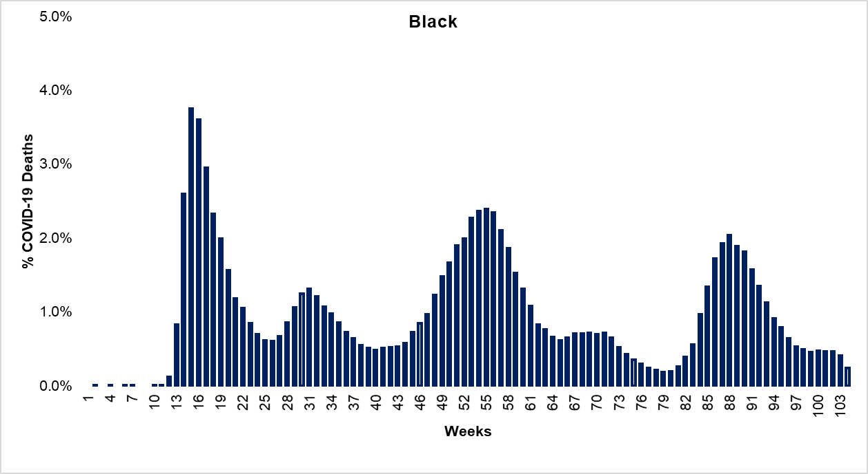

Slide 41
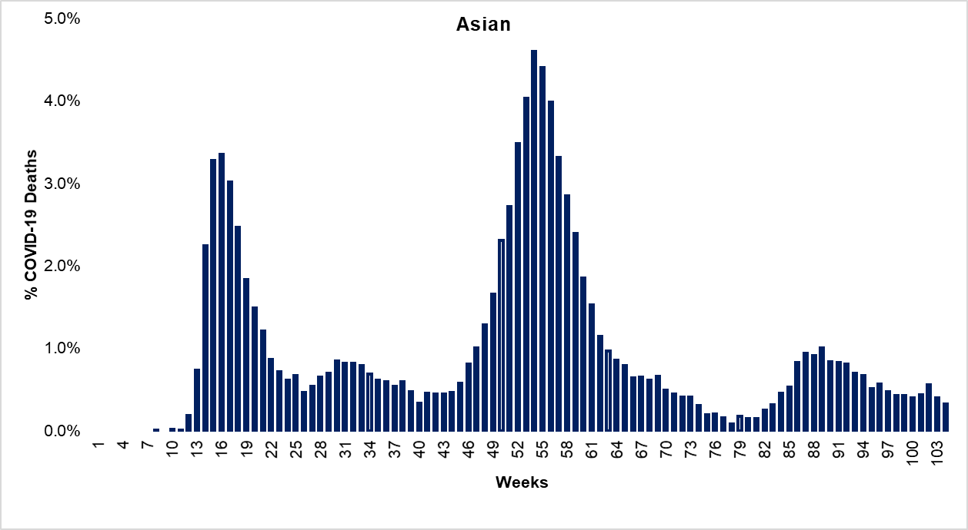

Slide 42
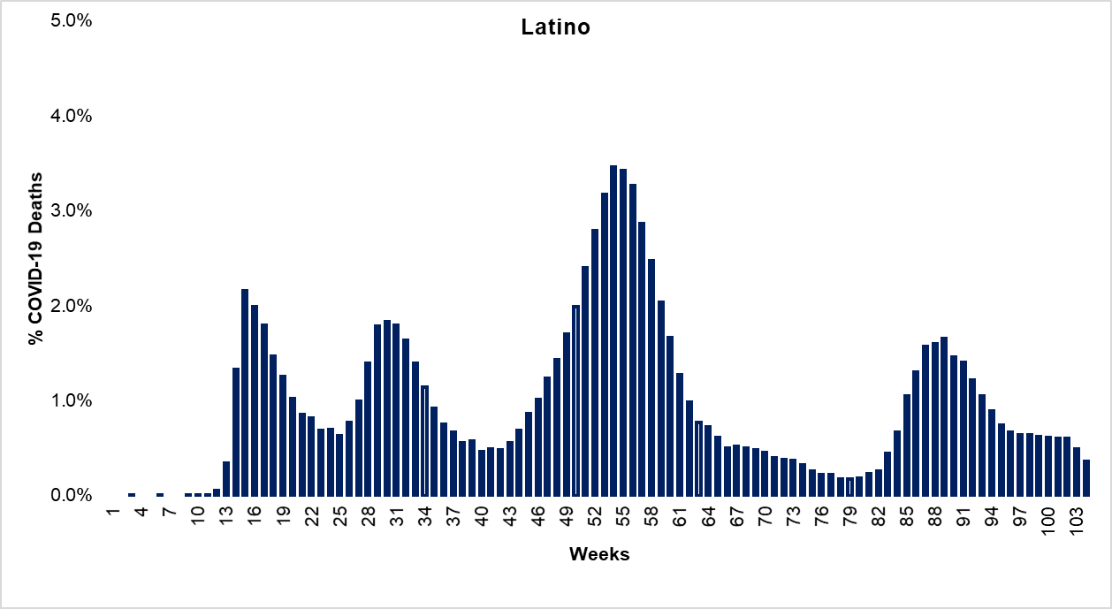

Slide 43
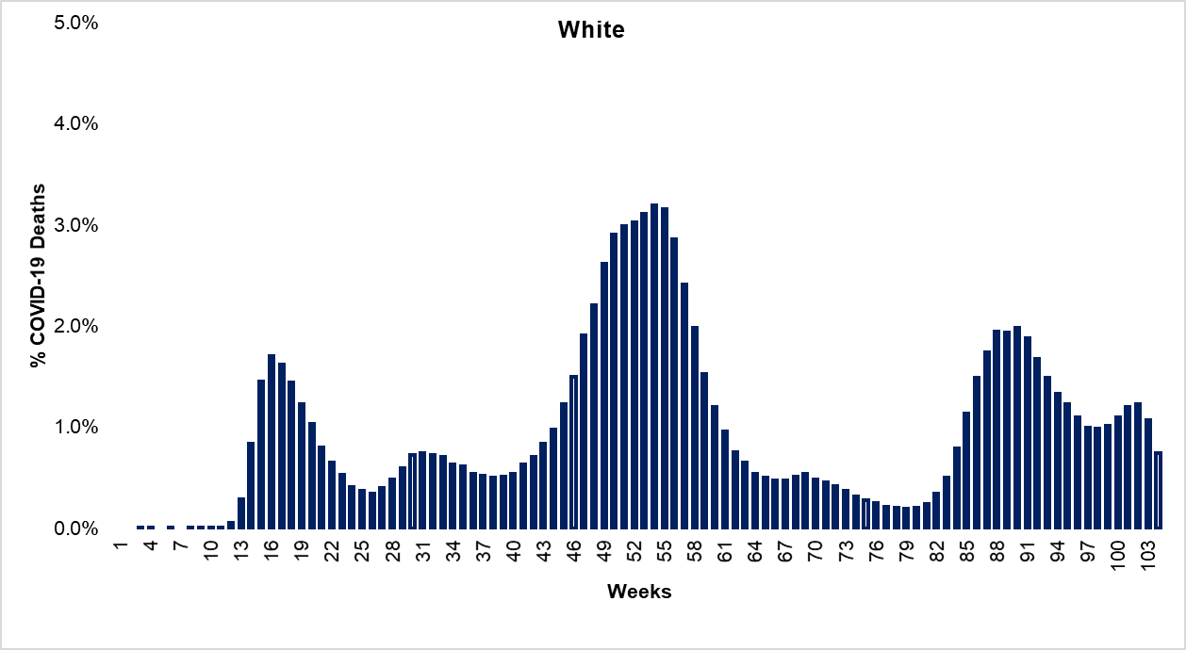

Slide 44
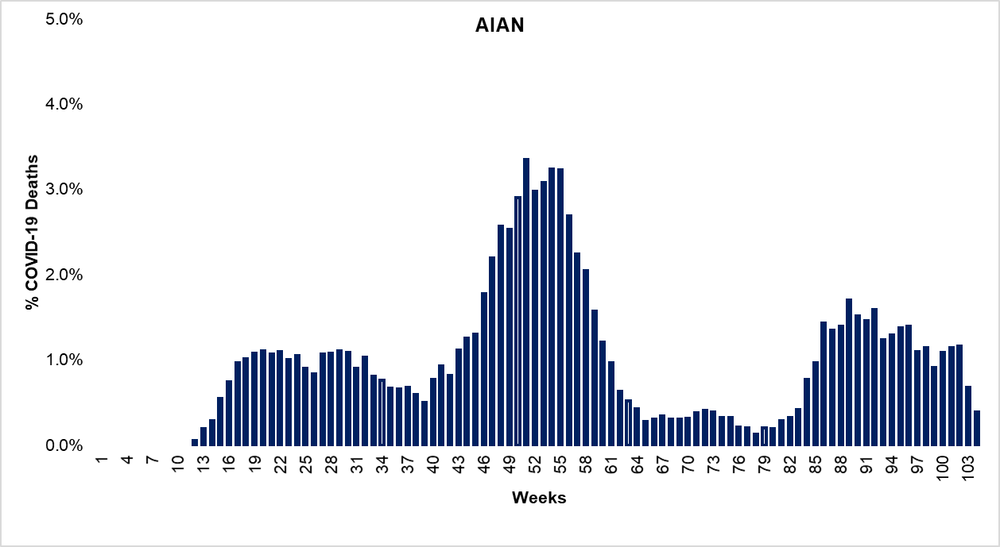

Slide 45
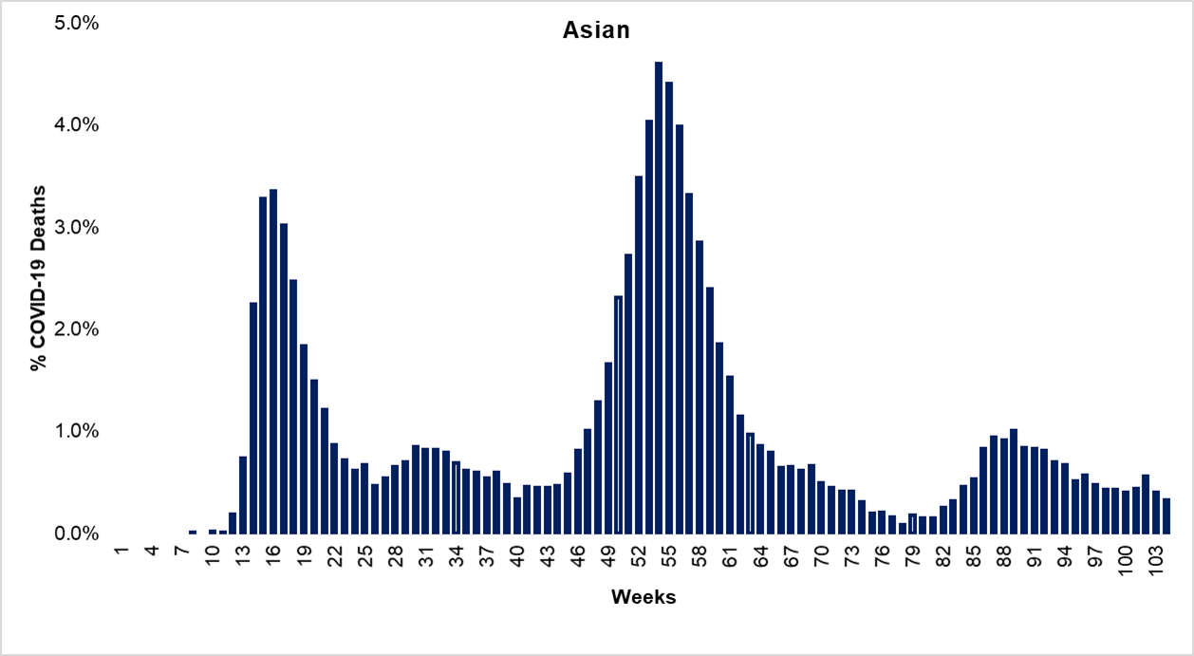

Slide 46
Rising White COVID-19 Deaths in Recent Times

Slide 47
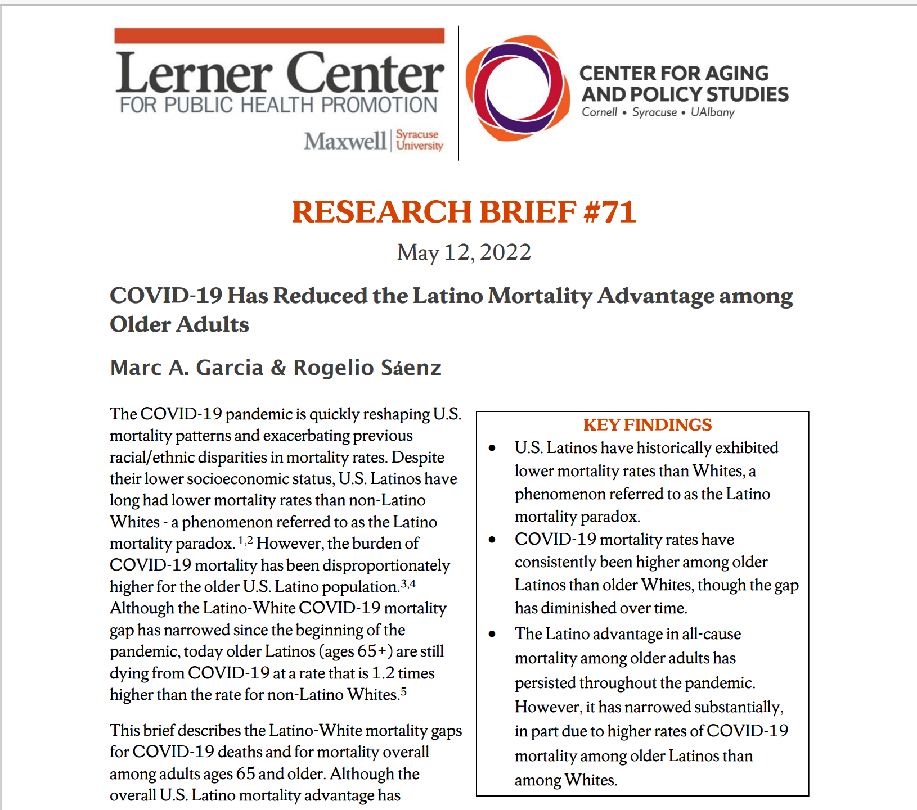

Slide 48
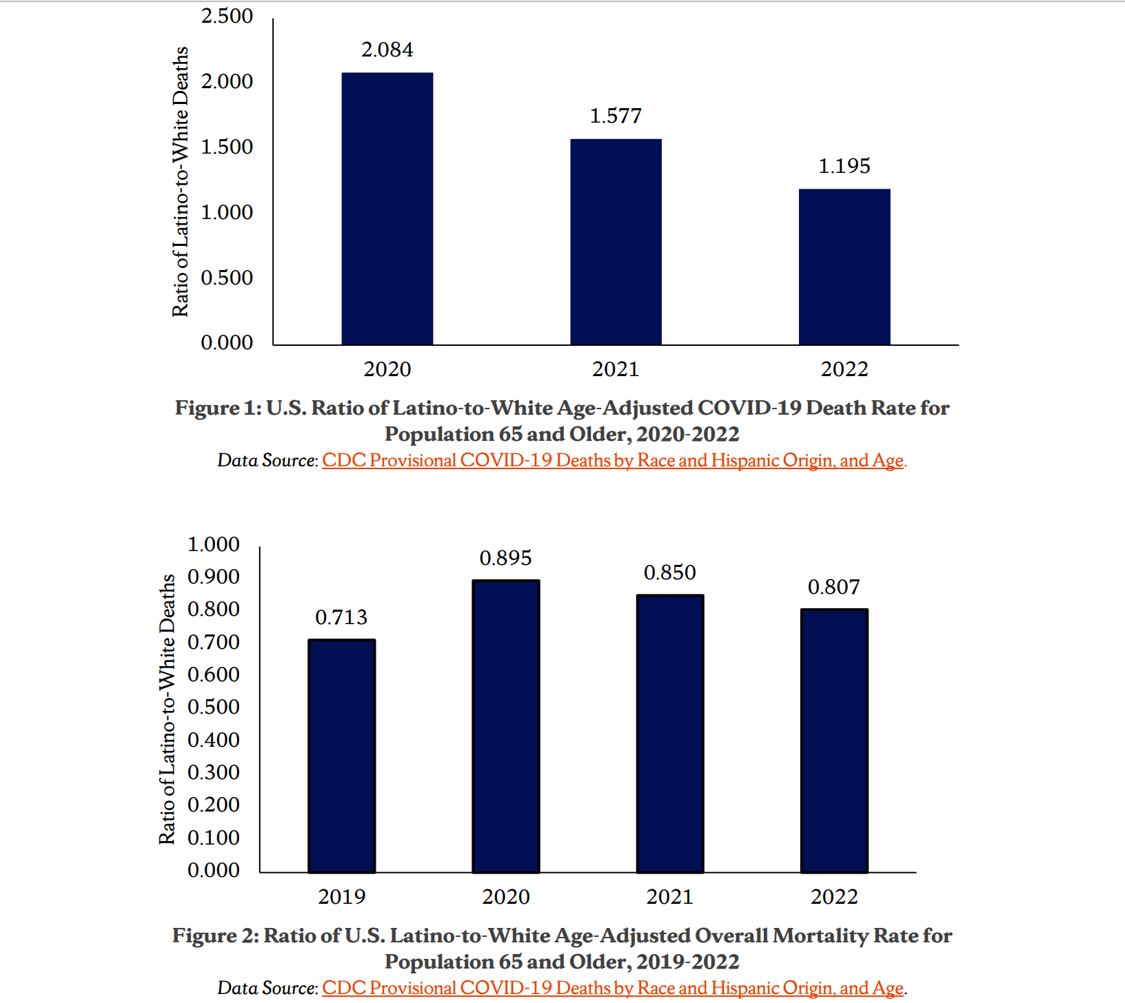

Slide 49
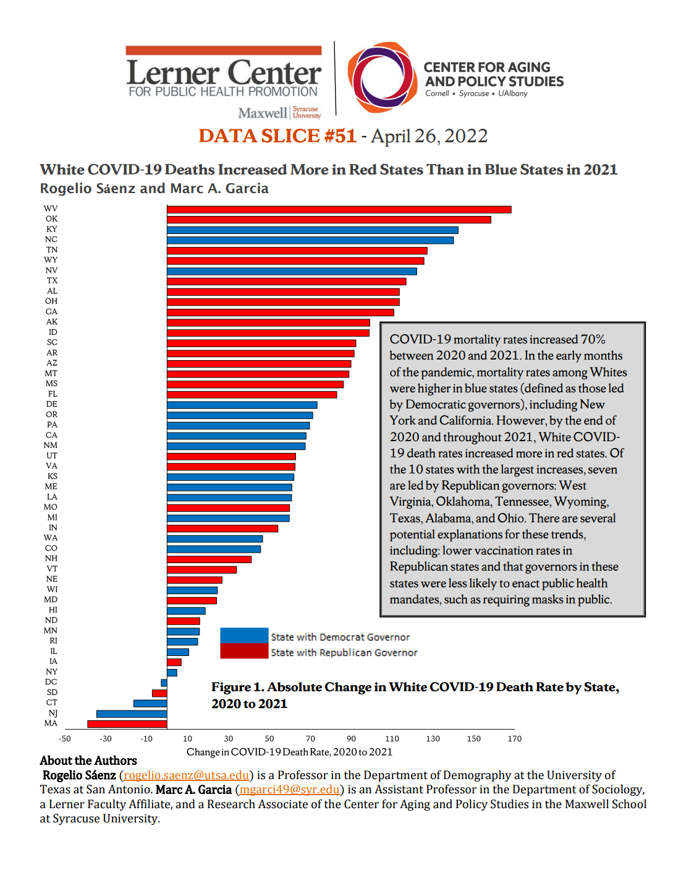

Slide 50
The Latest

Slide 51
Percent Change in COVID-19 Deaths by Race/Ethnic Group, 10/9/2021 to 10/8/2022

Slide 52
Percent Change in COVID-19 Deaths by Race/Ethnic Group, 1/2/2022 to 10/8/2022

Slide 53
Closing Thoughts
Latinos, Indigenous People, and Blacks disproportionately devasted by pandemic
Not a major surprise given systemic racism
Confluence of racial inequities that put people of color at elevated risks of contracting the coronavirus and succumbing to COVID-19
People of color disproportionately put in harms way as fodder for capitalism and for efforts to reelect Donald Trump and other Republican leaders
The rollout of vaccinations resulted in people of color again being disproportionately underrepresented among those receiving the vaccine
This appears to have changed somewhat among Latinos, Indigenous Peoples, and Asians
White mortality advantages narrowing somewhat and whites continue to have higher levels of increases, although death rates have been relatively lower than case of people of color asides Asians
Stay tuned…there continue to be changes

Slide 54
Thank you!
rogelio.saenz@utsa.edu

